Slide 1


Slide 2
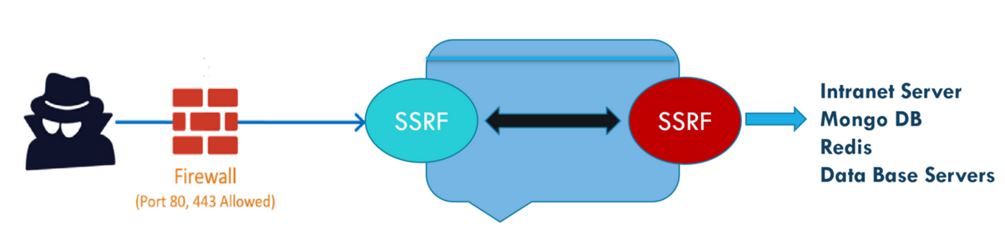

SERVER SIDE REQUEST FORGERY

Slide 3
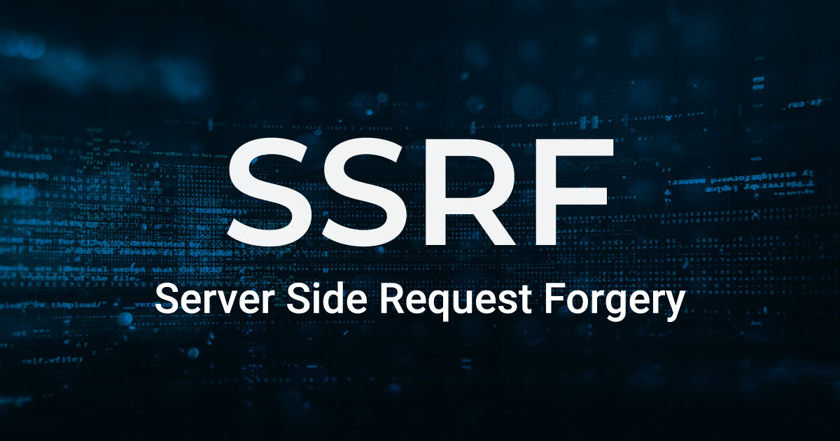
CONTENTS
What is Server Side Request Forgery (SSRF)
Types of Server Side Request Forgery
Impact of Server Side Request Forgery Vulnerability
How to find Server Side Request Forgery Vulnerability
Mitigation
Live Demo

Slide 4
What is ssrf
A SSRF attack allows an attacker to send crafted requests from the back-end server of a vulnerable application abusing the server functionality in order to access or modify sensitive information.
These type of attacks are usually performed to target the internal system present behind a firewall which are not accessible from an external network.
SSRF vulnerabilities ocur when an attacker has full or partial control over the request sent by a web application.
Eg :- Attacker having control over the third party service URL to which the web application makes a request.

Slide 5
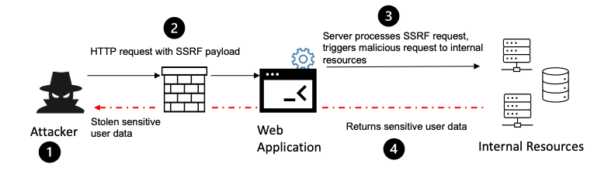

Slide 6
useful parameters to find ssrf
?dest={target}
?redirect={target}
?uri={target}
?path={target}
?continue={target}
?url={target}
?window={target}
?next={target}
?data={target}
?reference={target}
?site={target}
?html={target}
?val={target}
?validate={target}
?domain={target}
?callback={target}
?return={target}
?page={target}
?feed={target}
?host={target}
?port={target}
?to={target}
?out={target}
?view={target}
?dir={target}

Slide 7

Types of ssrf
There are two types of Server Side Request Forgery (SSRF)
Full response SSRF
Blind SSRF

Slide 8
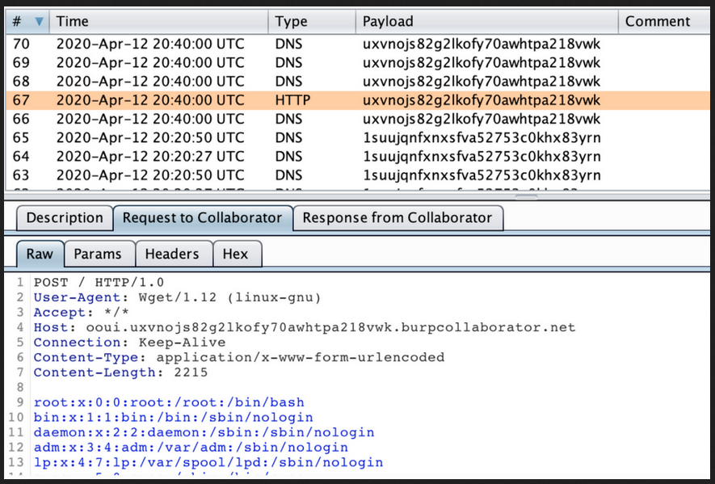
full response ssrf
In this type of SSRF, the internal server sensitive information present at the back-end server can be fetched through the HTTP response. This means that output result for the inserted query can be seen in the response itself.

Slide 9
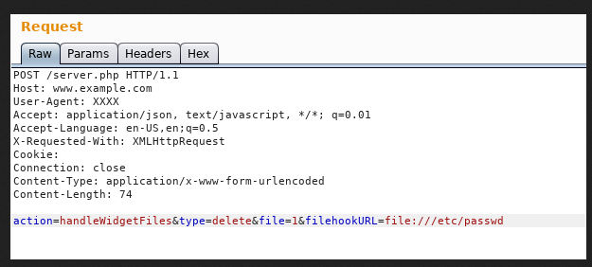
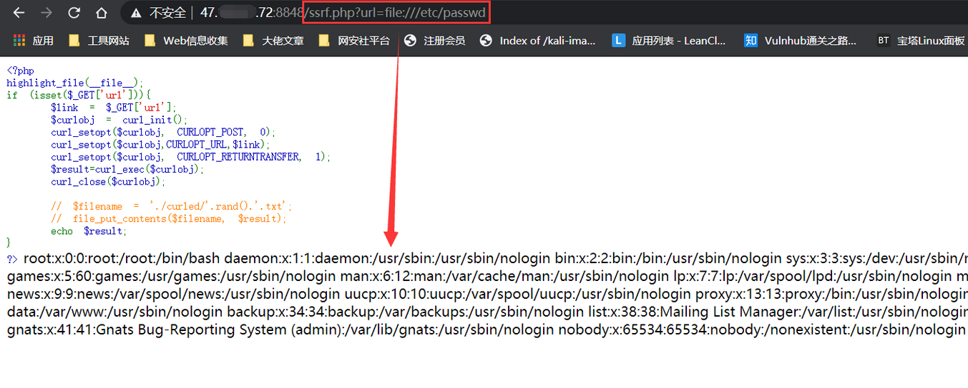

Slide 10
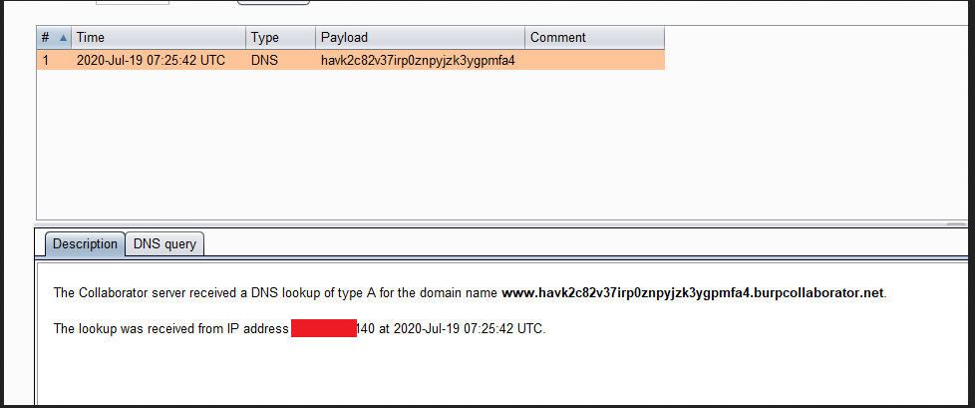
blind ssrf
In this type of SSRF, the internal server sensitive information of the back-end server cannot be fetched directly through HTTP response. Here the output result for the query inserted cannot be found in the response.

Slide 11
Blind SSRF :-
=> Examples:
Xmlrpc enabled SSRF
Blind SSRF with shellshock exploitation
Shellshock payload > https://github.com/swisskyrepo/PayloadsAllTheThings/blob/master/CVE%20Exploits/Shellshock%20CVE-2014-6271.py
https://github.com/assetnote/blind-ssrf-chains
=> Tools :-
Burp extender => Collaborator Everywhere

Slide 12
vulnerability rate taxanomy (VRT)

Slide 13
impact of ssrf vulnerability
A successful SSRF attack can often result in unauthorized actions or access to data within the organization, either in the vulnerable application itself or on other back-end systems that the application can communicate with. In some situations, the SSRF vulnerability might allow an attacker to perform arbitrary command execution.
An SSRF exploit that causes connections to external third-party systems might result in malicious onward attacks that appear to originate from the organization hosting the vulnerable application.

Slide 14

mitigation
To avoid SSRF, never trust user input.
If application needs to pass URLs in requests, use a whitelist for IP addresses and domains, and always validate if the response has the expected format and content.

Slide 15

PRACTICAL DEMO

Slide 16
resources :-
https://www.bugcrowd.com/glossary/server-side-request-forgery-ssrf/
https://hackingthe.cloud/aws/exploitation/ec2-metadata-ssrf/
https://hackerone.com/reports/1108418
https://hackerone.com/reports/1189367
https://cobalt.io/blog/a-pentesters-guide-to-server-side-request-forgery-ssrf
https://www.csoonline.com/article/3635894/ssrf-attacks-explained-and-how-to-defend-against-them.html

Slide 17
THANK YOU

